Slide 1
Smart Spreading Factor Assignment for LoRaWANs
Tugrul Yatagan
yatagan@itu.edu.tr
Advisor: Prof. Dr. Sema F. Oktug

Slide 2
Outline
Introduction
LoRaWAN
LoRa
Proposed Technique
Simulation Environment
Simulation Results

Slide 3
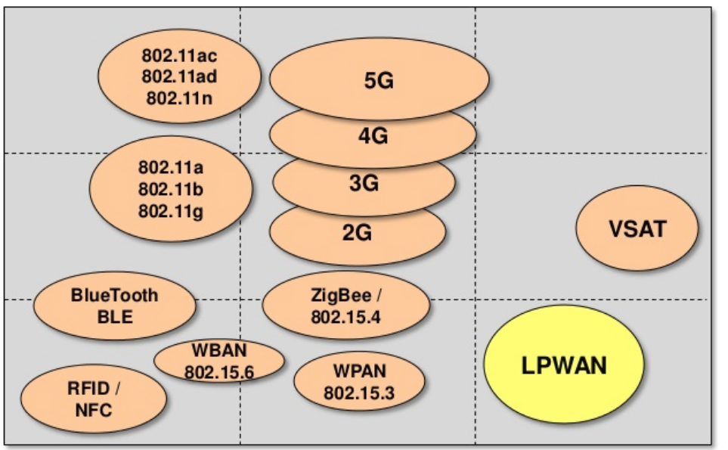
Introduction
LoRaWAN
LoRa
Proposed Technique
Simulation Environment
Simulation Results
Introduction: LPWAN Overview
Number of Internet of Things applications increased exponentially in last few years ^{[1]}
How to provide connectivity for low power devices distributed over large geographical areas?
Example LPWA application areas;
Smart city
Industrial assets monitoring
Smart grid metering
Agriculture
Logistic
DATA RATE
LPWAN fills the technology gap between:
Short range wireless technologies (ZigBee, Bluetooth, WiFi)
Range is limited to a few hundred meters at best
Very costly to deploy dense network
Cellular (2G, 3G, LTE)
Optimized for voice and data
Complex and expensive
High power consumption
RANGE
Figure 1: Wireless technologies with respect to range and data rate¹
1. Image Source: https://www.slideshare.net/PeterREgli/lpwan

Slide 4
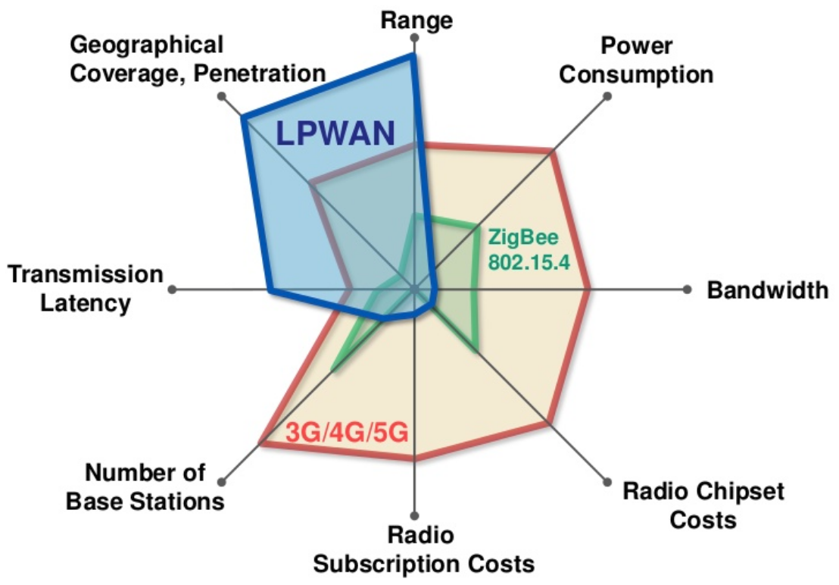
Introduction
LoRaWAN
LoRa
Proposed Technique
Simulation Environment
Simulation Results
Introduction: LPWAN Key Features
Low Power Wide Area networks:
Low power (ten years and beyond)
Long range (a few to tens of kilometers)
Low cost
Low data rate (in orders of tens of kilobits per second)
High latency (in orders of seconds or minutes)
LPWAN applicable applications:
Delay tolerant
Low data rates
Low power consumption
Low cost
Several competing LPWAN technologies and alliances:
LoRa
Sigfox
NB-IoT
LTE-M
Figure 2: Wireless technologies with respect to various properties¹
1. Image Source: https://www.slideshare.net/PeterREgli/lpwan
Notes:
LPWAN is not suitable for many industrial IoT, vehicle to vehicle (V2V), and vehicle to infrastructure (V2I) applications

Slide 5
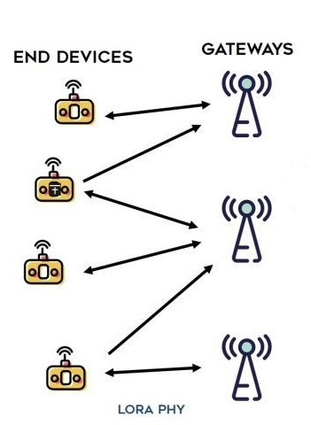
Introduction
LoRaWAN
LoRa
Proposed Technique
Simulation Environment
Simulation Results
LoRaWAN
LoRaWAN is open standard MAC layer protocol for LoRa physical layer, developed by LoRa Alliance
End Node (EN): Low power embedded device that only communicates to gateways
- Battery Powered: Class A
- Low Latency: Class B
- No Latency: Class C
Gateway (GW): Receive/transmit packets coming from/to end nodes
Network Server (NS): Routes messages from application to end nodes
The messages transmitted by the end devices are received by all the base stations in the range
Star of stars
Pure ALOHA
No CSMA/CA
No forwarding, no waiting for others’ messages to arrive
NS can request to change communication parameters of nodes
Spreading factor, transmit power
Move complexity to backend system
Figure 3: LoRaWAN Topology¹
1. Image Source: https://i1.wp.com/www.zerynth.com/wp-content/uploads/2017/05/lorawan-architecture.jpg
Notes:
not to waste precious energy in busy-listening to other devices
Simplify the design of end devices, move complexity to base stations and backend system

Slide 6
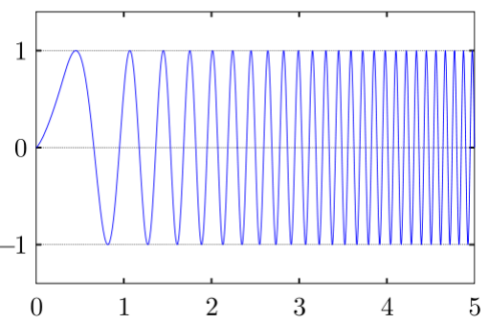
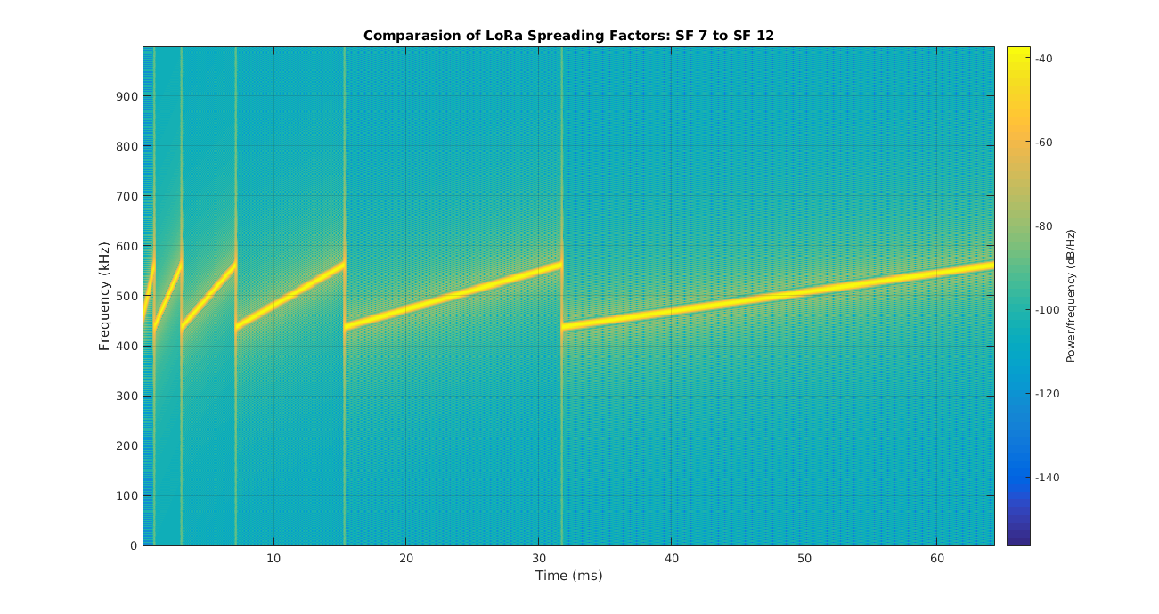
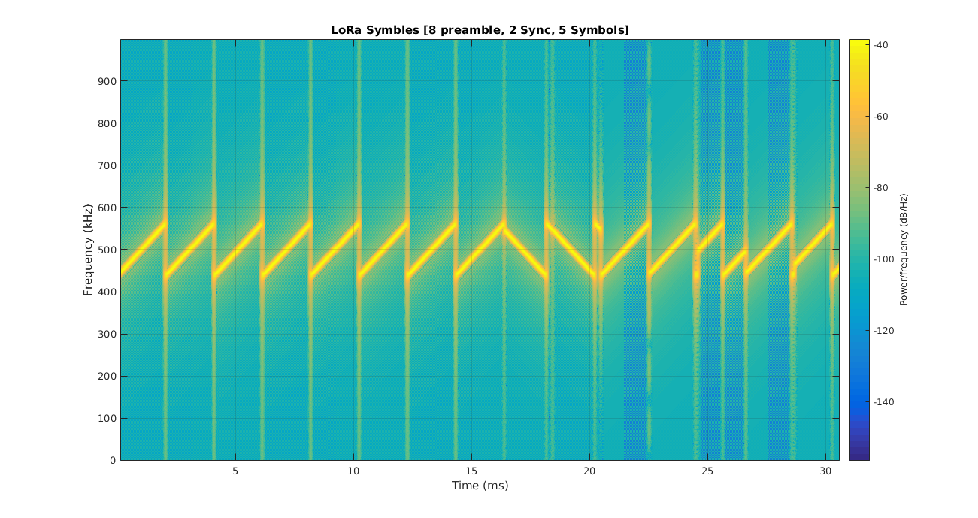
Introduction
LoRaWAN
LoRa
Proposed Technique
Simulation Environment
Simulation Results
LoRa: Modulation
LoRa modulates the signals in Sub-GHz ISM band using a proprietary modulation technique based on Chirp Spread Spectrum (CSS)
Chirp is a sinusoidal signal of frequency increase or decrease over time
Resilient to interference and noise
Figure 4: Chirp¹
Figure 5: LoRa modulation SF 7 to 12¹
Figure 6: LoRa modulation example¹
1. Image Source: http://www.sghoslya.com/p/lora-is-chirp-spread-spectrum.html
Notes:
Sub-GHz band; Lower frequency signals experience less attenuation and multipath fading
Spread spectrum; spread signal over a wider frequency band but with the same power density, Resilient to interference, harder to decode

Slide 7
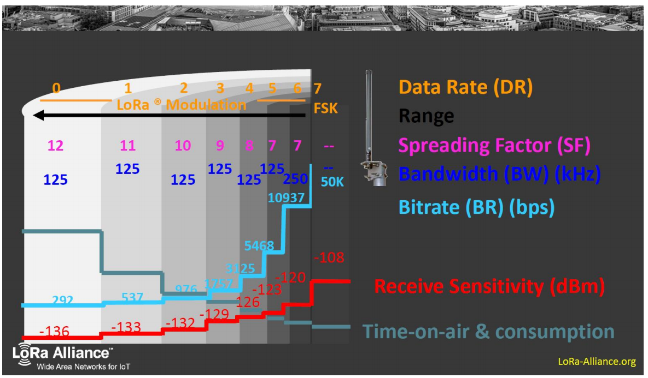
Introduction
LoRaWAN
LoRa
Proposed Technique
Simulation Environment
Simulation Results
LoRa: Spreading Factor
LoRa uses spreading factor for rate adaptation
Ratio between symbol rate and chirp rate
Can be 7 to 12
Provides tradeoff between data rate, range and power consumption
Lower SF:
Higher transmission rate
Shorter transmission time
But requires a higher SNR
Shorter range
SFs are orthogonal up to some extent:
Packets with different SFs in same channel can be received simultaneously
Figure 7: LoRa CSS modulation SF, data rate, time-on-air comparision¹
1. Image Source: https://home.zhaw.ch/~rumc/wcom2/unterlagen/wcom2chap3CSS.pdf
Notes:
Higher spreading factors delivers long range at an expense of lower data rate and high power consumption

Slide 8
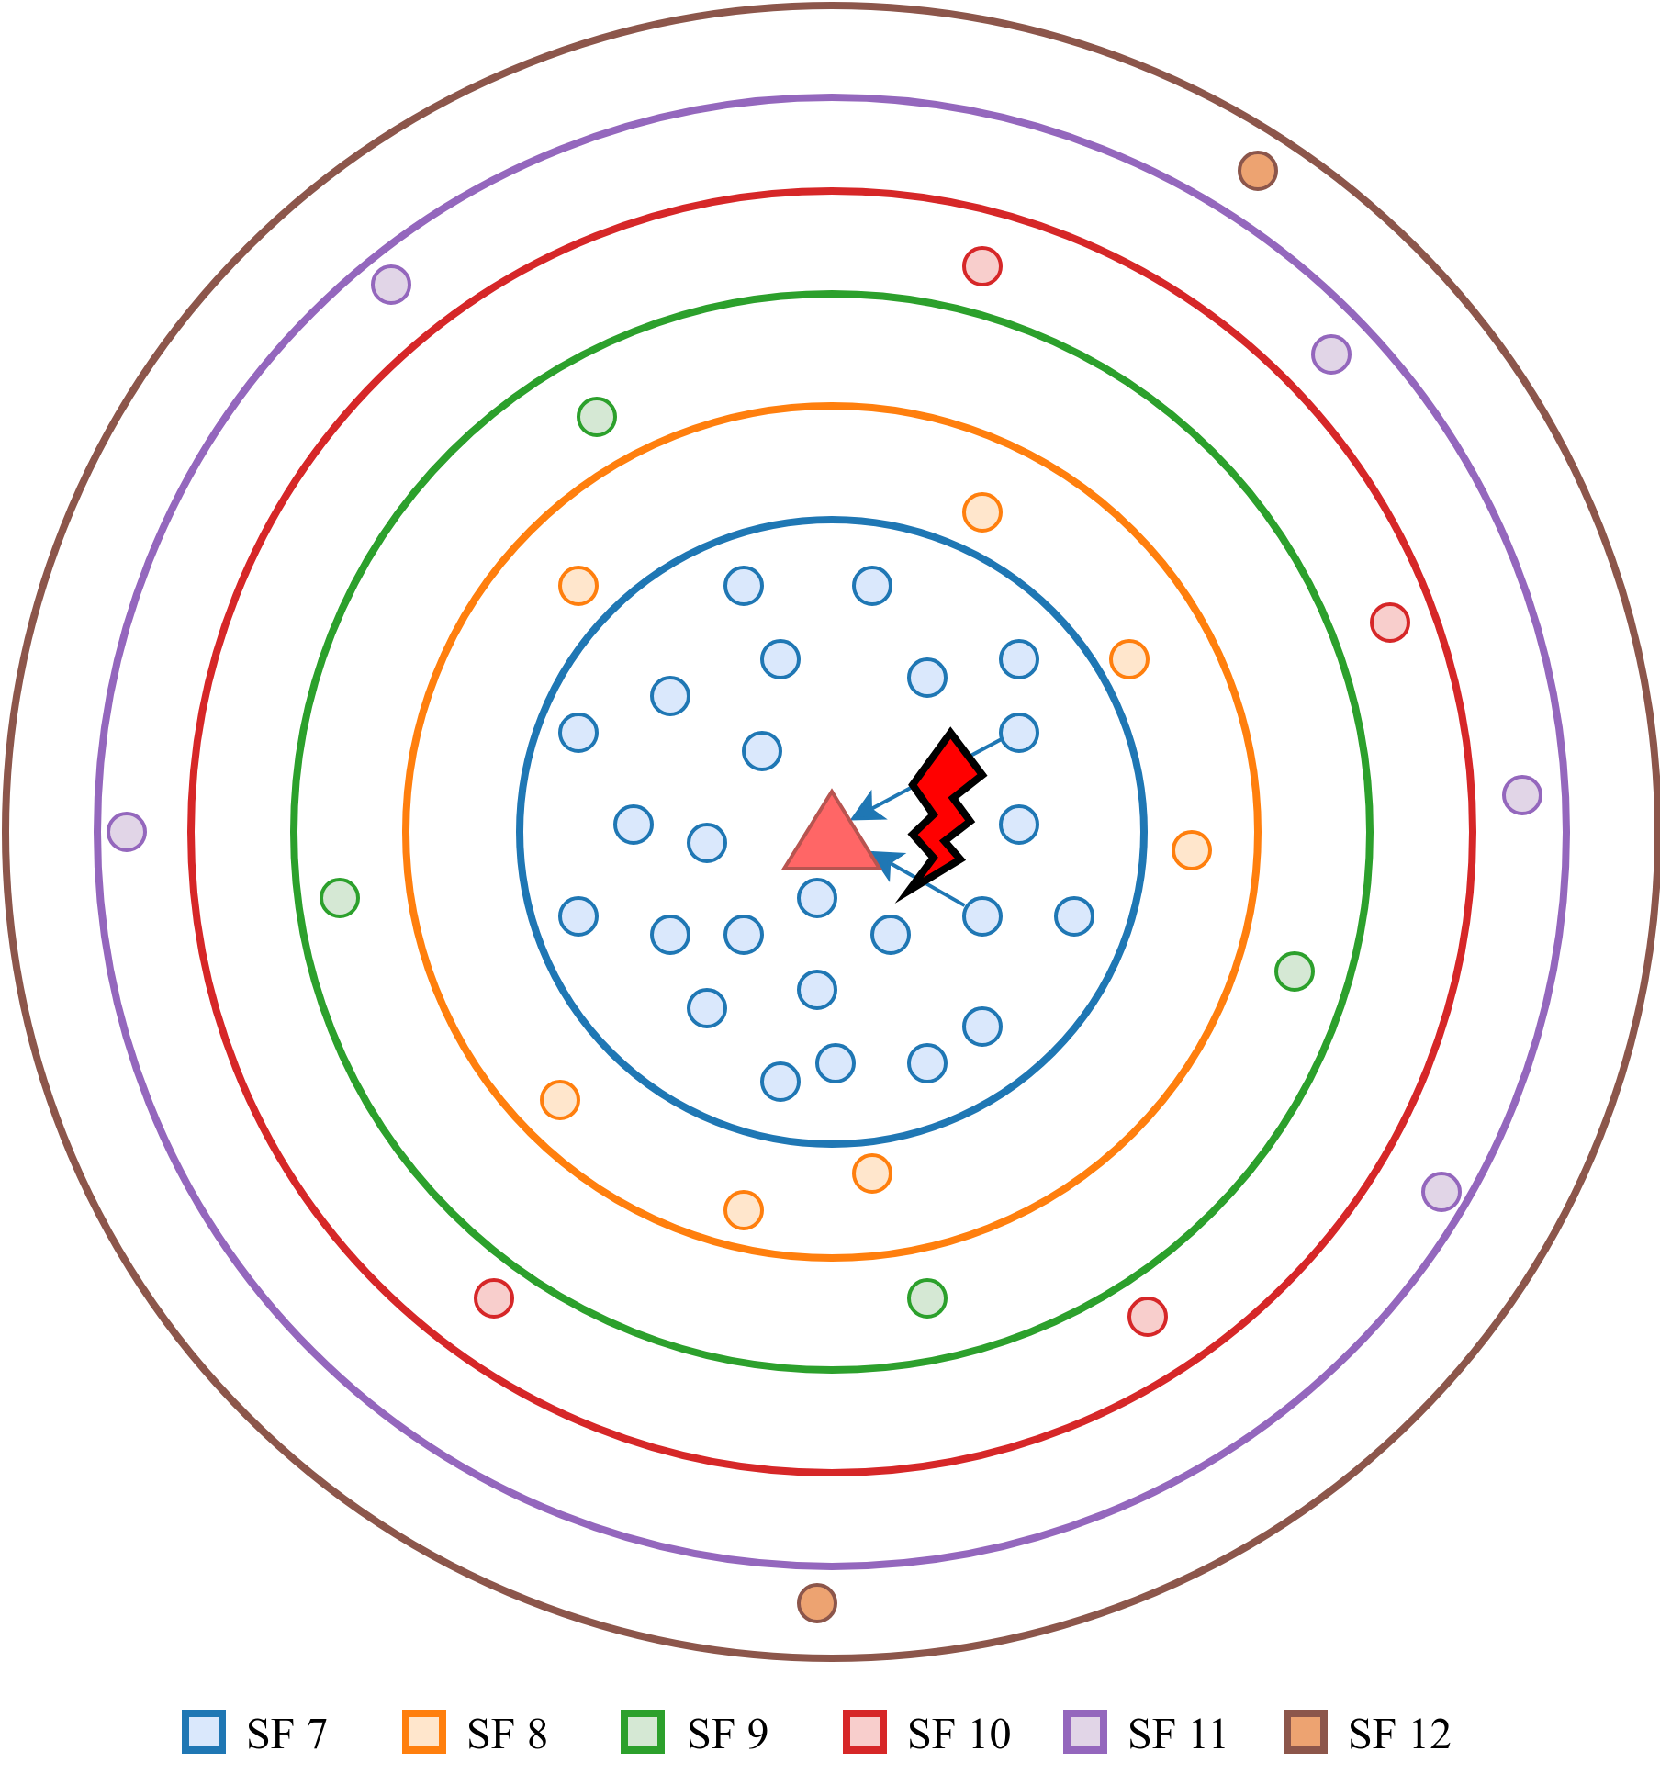
Introduction
LoRaWAN
LoRa
Proposed Technique
Simulation Environment
Simulation Results
Proposed Technique: Issue
End nodes select SF according to signal strength of the downlink transmission from GW
End nodes which close to the GW will probably select lowest SF all the time
Same SF transmission collision
Number of collisions increases while number of end devices close to the GW increases
Figure 8: SF assignment issue on single gateway

Slide 9
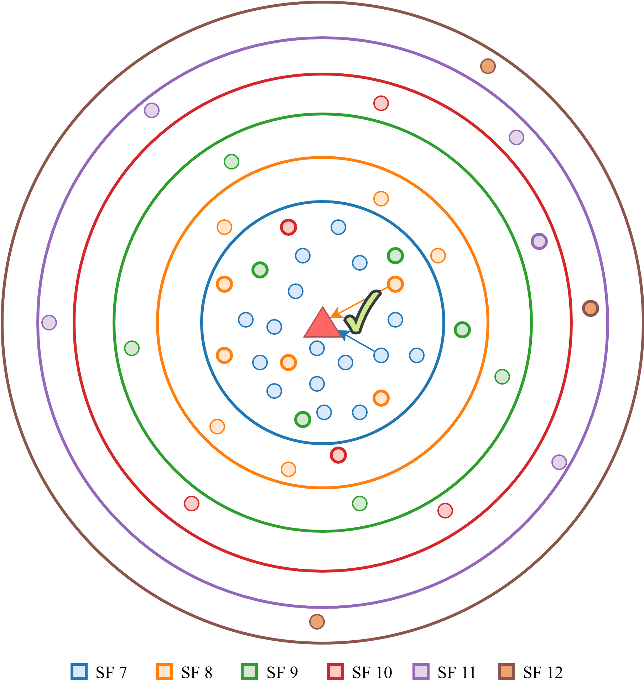
Introduction
LoRaWAN
LoRa
Proposed Technique
Simulation Environment
Simulation Results
Proposed Technique: Solution
Network server can force some of the close end nodes to select higher SF
Number of collision may decrease due to the orthogonality of different SF
However, higher SF:
Higher time on air
Prone to collision with other higher SF transmissions
How network server should assign which SF to which node?
Figure 9: SF assignment issue proposal

Slide 10
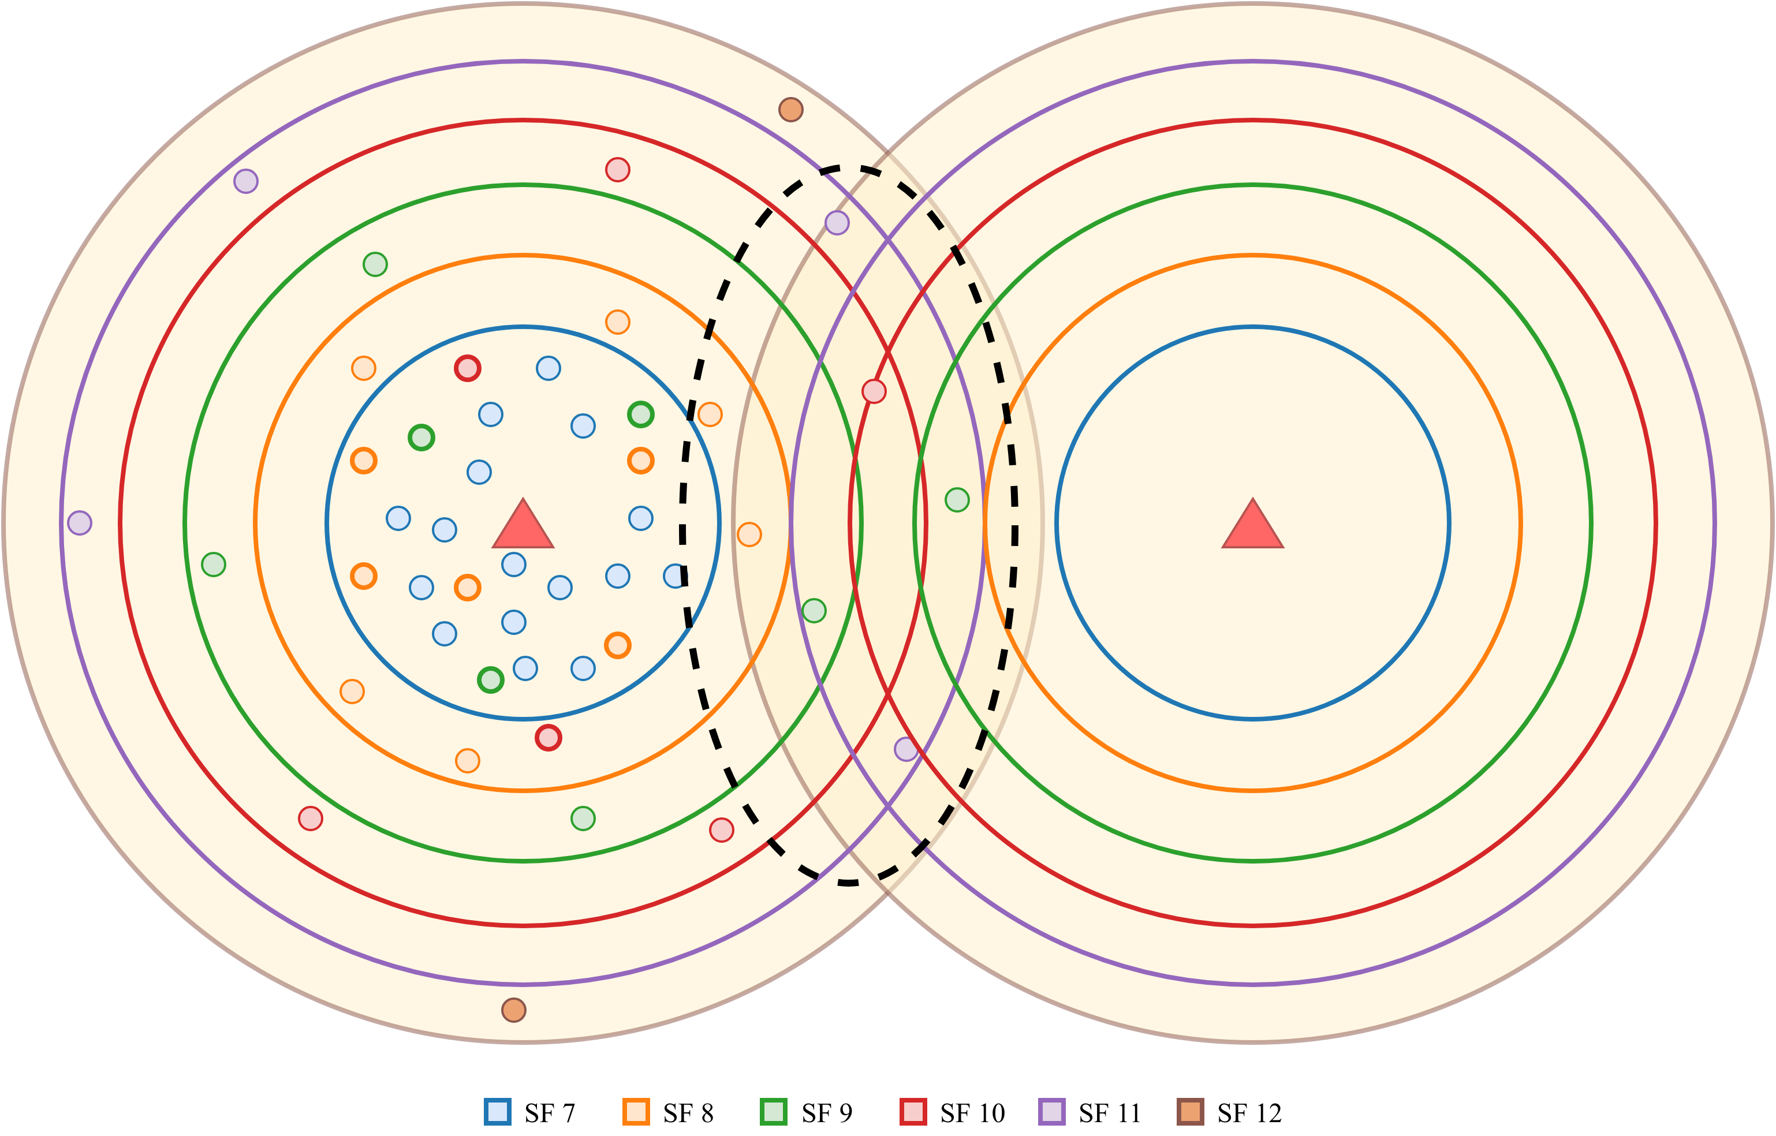
Introduction
LoRaWAN
LoRa
Proposed Technique
Simulation Environment
Simulation Results
Proposed Technique: Solution
This approach may increase the collisions with nodes in other GW's range
Extra care must be taken for nodes in intersection area
Figure 10: SF assignment issue on multiple gateway

Slide 11
Introduction
LoRaWAN
LoRa
Proposed Technique
Simulation Environment
Simulation Results
Proposed Technique
NS can keep track of transmission logs:
Location
Latitude and longitude
Spreading factor
Transmission result
Successful
Interfered
Under sensitivity
NS can train a model for predicting transmission result for a specific location and specific spreading factor
NS can assign the lowest possible SF to nodes considering prediction of transmission

Slide 12
Introduction
LoRaWAN
LoRa
Proposed Technique
Simulation Environment
Simulation Results
Simulation Environment
A discrete event simulator is implemented to study effects of different SF strategies in LoRaWANs
Open space propogation loss model
Co-technology interference model
Network topology input parameters:
Radius (m)
Number of nodes
Number of gateways
Simulation input parameters:
Duration (s)
Packet size (B)
Packet generation rate (p/s)
Spreading factor assignment method
Simulation outputs:
Number of generated packets, successfully received packets, interfered packets, under sensitivity packets
Network packet delivery ratio percentage (PDR)
Network throughput (bps)
Total transmit energy consumption

Slide 13
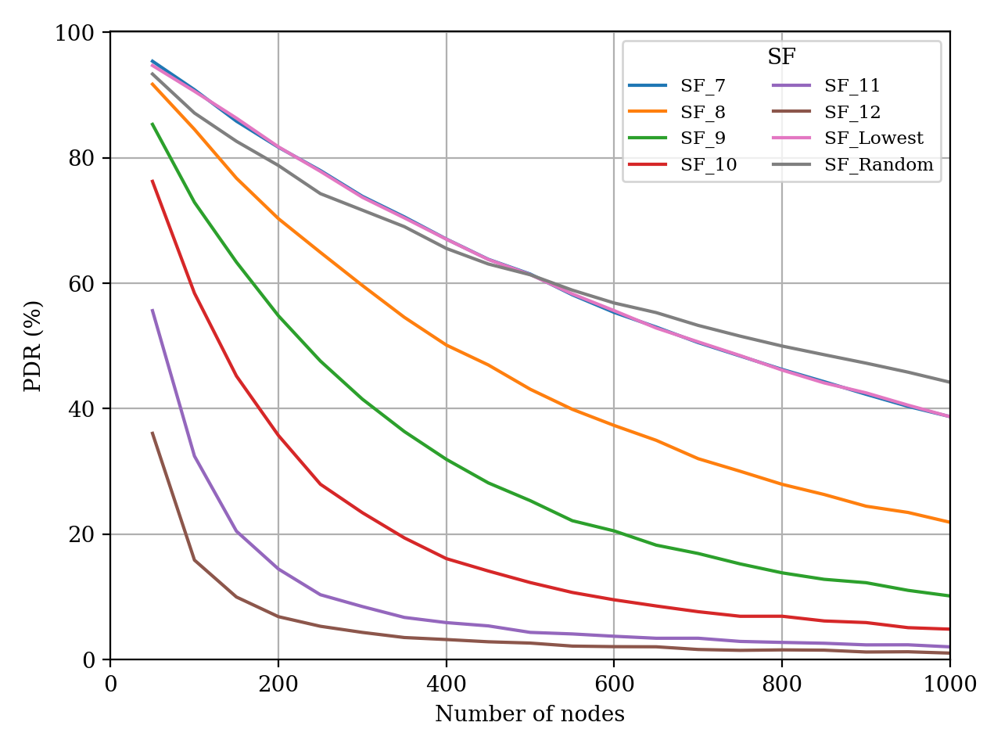
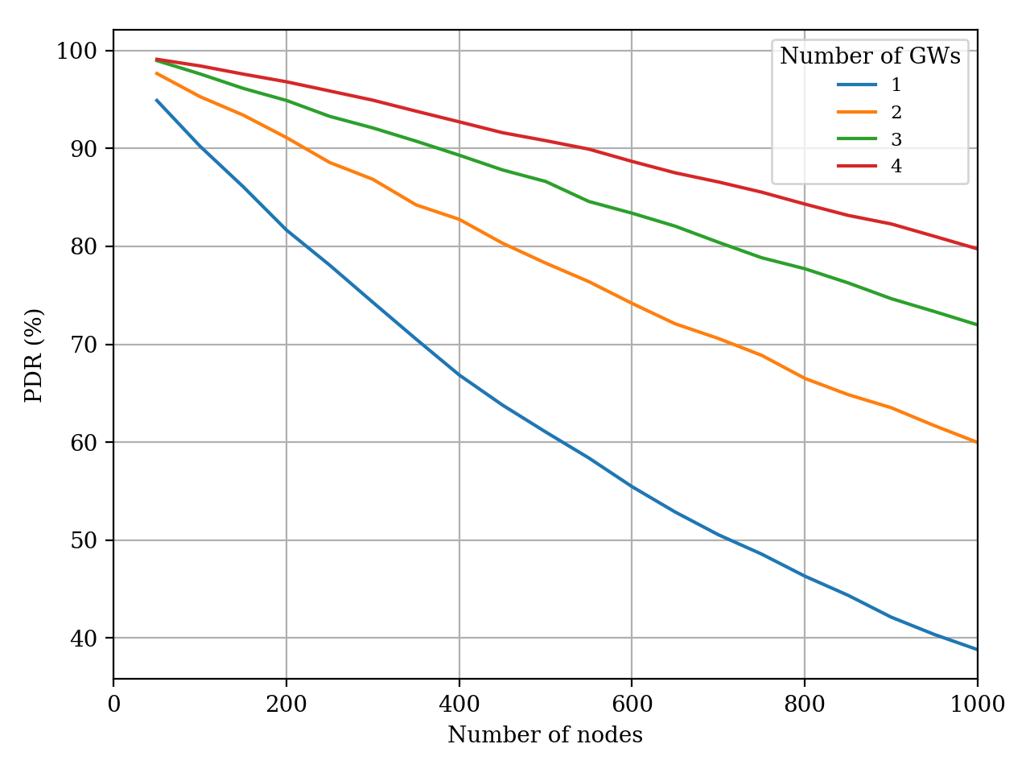
Introduction
LoRaWAN
LoRa
Proposed Technique
Simulation Environment
Simulation Results
Simulation Results
Topology radius is 3000 meters, packet generation rate is 0.01 packet per second
Figure 11: PDR of different SFs
Figure 12: PDR of different number of gateways
Notes:
Increasing SFs, increases time on air. This increases the number of collisions thus decreases the PDR of the network. PDR of higher SFs are decreased to almost 0 while number of node is increasing. Since network topology radius is quite small almost all SFs can reach to the GW.
Increasing number of GWs, decreases the SFs of nodes and decreases time on air. This decreases number of collisions thus increases the PDR of the network when network topology radius is constant

Slide 14
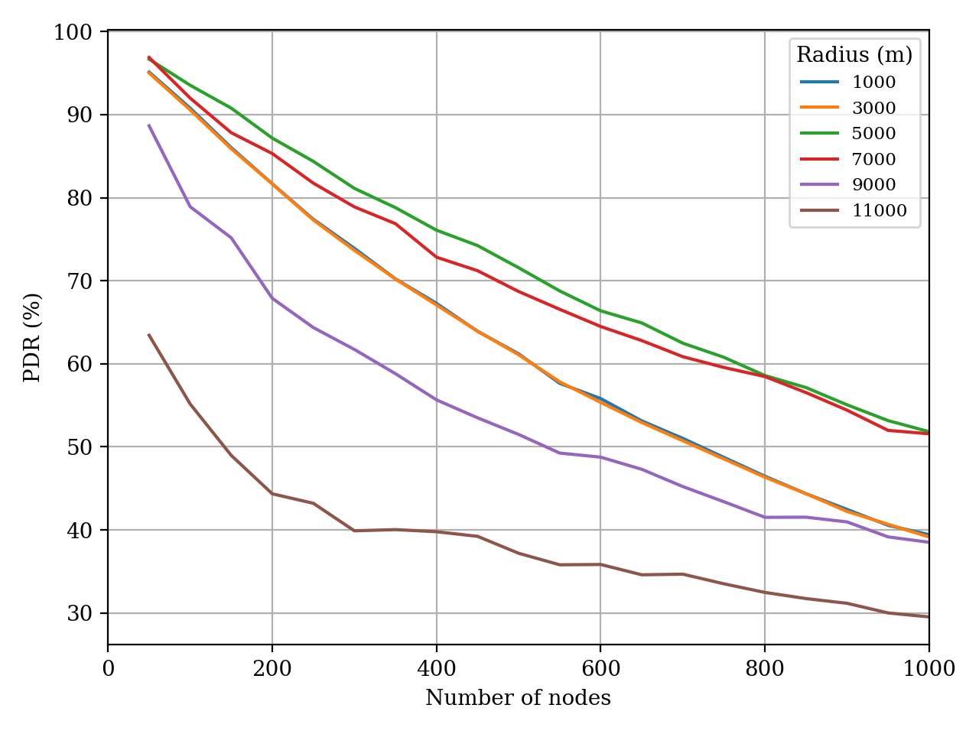
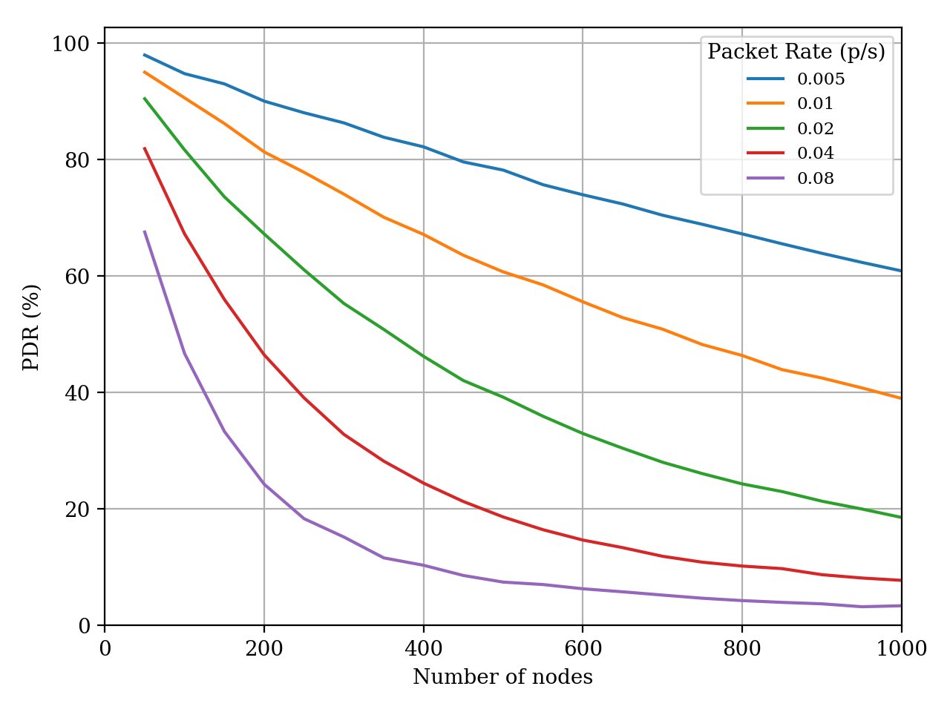
Introduction
LoRaWAN
LoRa
Proposed Technique
Simulation Environment
Simulation Results
Simulation Results
Number of GW is 1, packet generation rate is 0.01 packet per second, lowest possible SF assignment scheme
Figure 13: PDR of different topology radius
Figure 14: PDR of different packet rates
Notes:
Increasing network topology radius, increases the number of under sensitivity transmissions thus decreases the PDR of the network.
Increasing packet generation rate, increases the number of collisions thus decreases the PDR of the network.

Slide 15
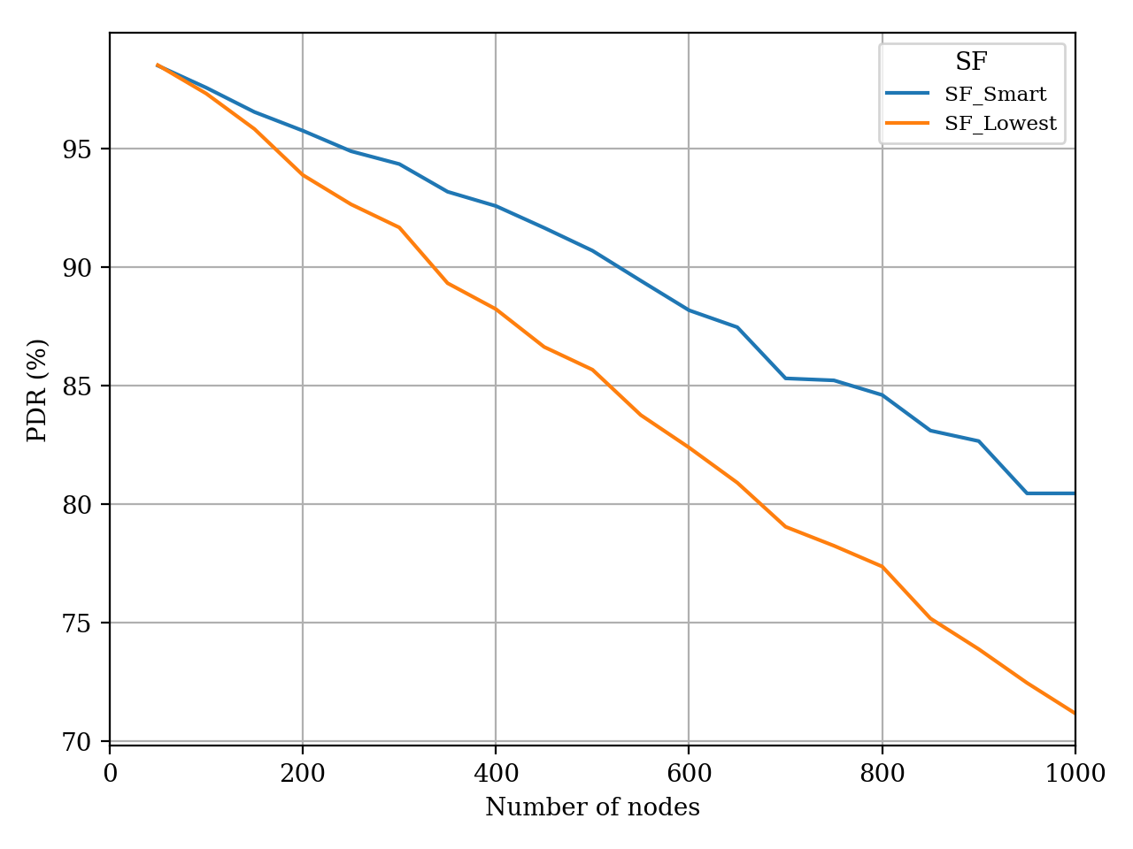
Introduction
LoRaWAN
LoRa
Proposed Technique
Simulation Environment
Simulation Results
Simulation Results
Topology radius is 5000 meters, number of GW is 3, packet generation rate is set to 0.01 packet per second
At least 3 GW is required to locate nodes positions by triangulation
Python scikit-learn decision tree classifier is used
Prediction scheme gives better PDR when:
Number of nodes increases
Interference increases
Nodes are deployed close to the gateway
Nodes have margin to increase SF
Figure 15: PDR of SF prediction scheme
Notes:
Prediction scheme gives better PDR when number of nodes increases since number of interference is also increases
Prediction scheme can only improve network performance when LoRa interference is present
If a node is far away from the GW, then prediction scheme cannot increase the SF to avoid interference since the SF is already high.

Slide 17
References
M. Centenaro, L. Vangelista, A. Zanella and M. Zorzi, "Long-range communications in unlicensed bands: the rising stars in the IoT and smart city scenarios," in IEEE Wireless Communications, vol. 23, no. 5, pp. 60-67, October 2016.
U. Raza, P. Kulkarni and M. Sooriyabandara, "Low Power Wide Area Networks: An Overview," in IEEE Communications Surveys & Tutorials, vol. 19, no. 2, pp. 855-873, Secondquarter 2017.
O. Georgiou and U. Raza, "Low Power Wide Area Network Analysis: Can LoRa Scale?," in IEEE Wireless Communications Letters, vol. 6, no. 2, pp. 162-165, April 2017.
“Lora modulation basics,” Semtech Corporation, Camarillo, California, USA, Tech. Rep. AN1200.22, May 2015. [Online]. Available: https://www.semtech.com/uploads/documents/an1200.22.pdf
D. Magrin, M. Centenaro and L. Vangelista, "Performance evaluation of LoRa networks in a smart city scenario," 2017 IEEE International Conference on Communications (ICC), Paris, 2017, pp. 1-7.
F. Van den Abeele, J. Haxhibeqiri, I. Moerman and J. Hoebeke, "Scalability Analysis of Large-Scale LoRaWAN Networks in ns-3," in IEEE Internet of Things Journal, vol. 4, no. 6, pp. 2186-2198, Dec. 2017.
J. Haxhibeqiri, F. Van den Abeele, I. Moerman, and J. Hoebeke, “Lora scalability: A simulation model based on interference measurements,” Sensors, vol. 17, no. 6, 2017. [Online]. Available: http://www.mdpi.com/1424-8220/17/6/1193
D. Croce, M. Gucciardo, S. Mangione, G. Santaromita and I. Tinnirello, "Impact of LoRa Imperfect Orthogonality: Analysis of Link-Level Performance," in IEEE Communications Letters, vol. 22, no. 4, pp. 796-799, April 2018.
A. Mahmood, E. Sisinni, L. Guntupalli, R. Rondon, S. A. Hassan, and M. Gidlund, “Scalability analysis of a lora network under imperfect orthogonality,” IEEE Transactions on Industrial Informatics, pp. 1–1, 2018.
“Lorawan 1.1 regional parameters,” LoRa Alliance, San Ramon, California, USA, Tech. Rep. v1.1rB, January 2018. [Online]. Available: https://lora-alliance.org/sites/default/files/2018-04/lorawantm regional parameters v1.1rb - final.pdf
“Sx1276/77/78/79 - 137 mhz to 1020 mhz low power long range transceiver datasheet,” Semtech Corporation, Camarillo, California, USA, Tech. Rep., August 2016. [Online]. Available: https://www.semtech.com/uploads/documents/DS SX1276-7-8-9 W APP V5.pdf
“Radio frequency (rf) system scenarios,” ETSI, Tech. Rep. TR 136 942 V13.0.0, January 2016. [Online]. Available: https://www.etsi.org/deliver/etsi tr/136900 136999/136942/13.00.00 60/tr 136942v130000p.pdf
C. Goursaud and J.-M. Gorce, “Dedicated networks for IoT : PHY / MAC state of the art and challenges,” EAI endorsed transactions on Internet of Things, Oct. 2015. [Online]. Available: https://hal.archives-ouvertes.fr/hal-01231221

